Slide 1
OVERVIEW
Here we aim to combine two datasets and get information from the data to take decisions. We are provided with two datasets containing the pedestrian counting in a particular area. The solution will load and stage the data in an appropriate format to enable efficient querying.

Slide 2
BUSINESS REQUIREMENTS
The following are the business requirements for the solution:
Show the top 10 (most pedestrians) locations by day.
Show the top 10 (most pedestrians) locations by month.
Which location has shown most decline due to lockdowns in last 3 years
Which location has most growth in last year
Load and stage data in an appropriate format for future querying.
Suggest other metrics that can be derived from these datasets.
Describe the data model and include a diagram

Slide 3
DATASETS
Sensors Table
sensor_id: the unique identifier for a sensor (primary key)
sensor_description: description of the sensor
sensor_name: name of the sensor
installation_date: the date the sensor was installed
sensor_status: status of the sensor
note: additional notes for the sensor
direction_1: the first direction the sensor is facing
direction_2: the second direction the sensor is facing
latitude: the latitude of the sensor
longitude: the longitude of the sensor
location: the location of the sensor
Counts Table
ID: the unique identifier for a count (primary key)
Date_Time: the date and time of the count
Year: the year of the count
Month: the month of the count
Date: the day of the count
Day: the day of the week of the count
Time: the time of the count
Hourly_Counts: the number of pedestrians counted in an hour
Sensor_ID: the identifier for the sensor that recorded the count (foreign key)
Sensor_Name: the name of the sensor that recorded the count

Slide 4
DESIGN
The solution will use Python and SQLite to extract the metrics from the datasets. The data will be staged in SQLite tables for efficient querying. The data will be loaded from CSV files into pandas DataFrames, and then merged based on the sensor_id and Sensor_ID columns. The datetime column will be converted to a datetime object to enable extracting the year, month, day, and hour.
We need to identify the requirements and analyse them to understand the data needed to meet those requirements. Based on the requirements provided, we need to extract statistics related to the most crowded locations, the locations that have shown the most decline or growth, and loading and staging data in a format that can be queried in the future. We also need to suggest other metrics that can be derived from the data sets.
The following libraries will be used:
PANDAS
It is a popular data manipulation and analysis library in Python. It provides data structures and functions to efficiently work with structured data, such as tables or spreadsheets. It is commonly used for data cleaning, transformation, and analysis tasks.
SQLITE3
It is a built-in Python module that provides an interface to interact with SQLite databases. SQLite is a lightweight, serverless database engine that allows for easy integration into applications.
OS
It is a module that provides a way to use operating system-dependent functionality in Python. It offers various functions for interacting with the file system, including file and directory manipulation, environment variables, and system-related operations.
DATETIME AND TIMEDELTA
These modules provide classes and functions to work with dates, times, and time intervals in Python. They allow for convenient manipulation and calculation of dates and times, such as adding or subtracting time intervals, formatting dates, and extracting specific components (year, month, day, etc.) from timestamps.

Slide 5
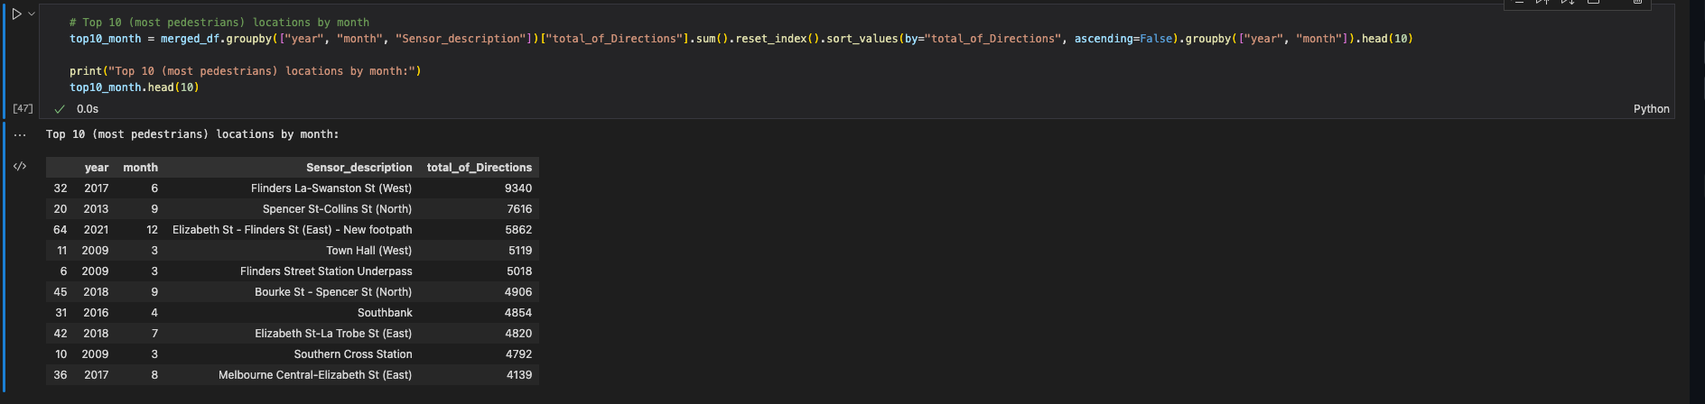
Top 10 (most pedestrians) locations by month

Slide 6
Most decline in the last 3 years

Slide 7
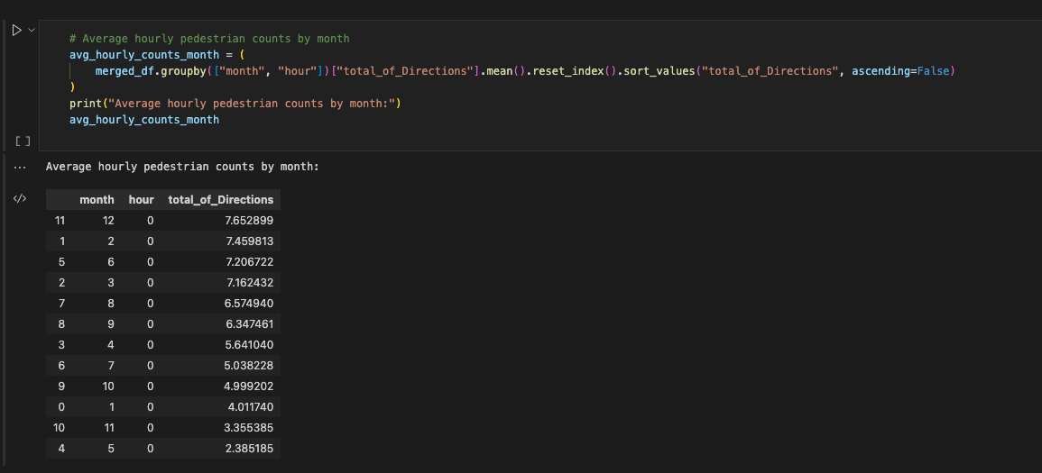
Average hourly pedestrian counts by month

Slide 8
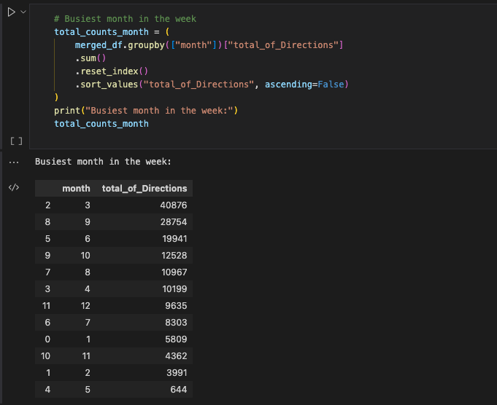
Busiest month in the week

Slide 9
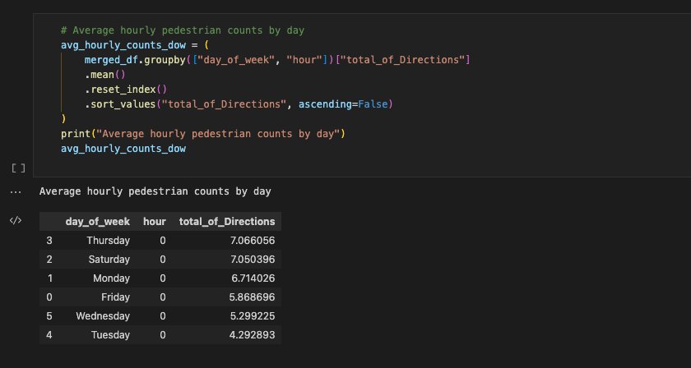
Average hourly pedestrian counts by day

Slide 10
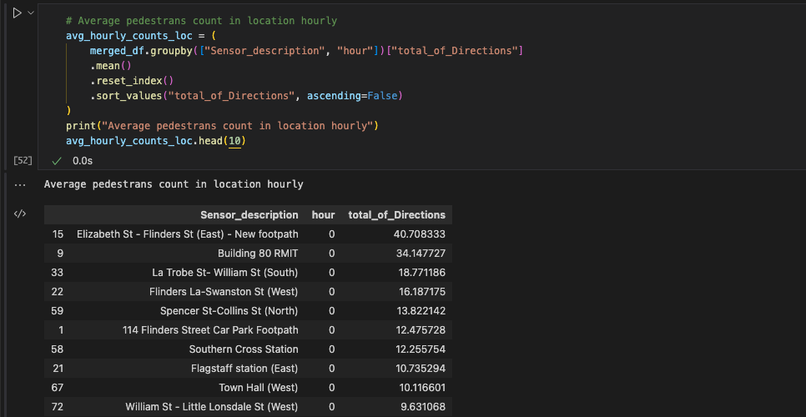
Average pedestrians count in location hourly

Slide 11
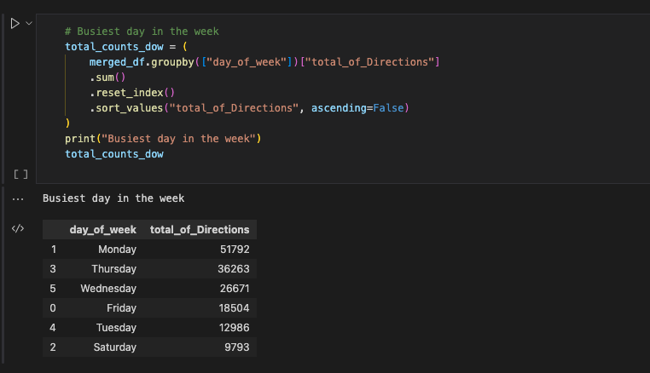
Busiest day in the week

Slide 12
We create a diagram to visualize the data model and the relationships between the tables.
Sensors data
location_id -- int
Counts data
LocationID -- int
SensingDateTime -- varchar
SensingDate --date
SensingTime -- time
Direction_1-- int
Direction_2-- int
total_of_Directions-- int
Sensor_description -- varchar
sensor_name -- varchar
Installation_date.-- varchar
Note -- varchar
location_type -- varchar
Status -- varchar
Direction_1 -- varchar
Direction_2 -- varchar
Latitude -- float
Longitude -- float
Location --varchar

Slide 13
Tables are created these way
CREATE TABLE Sensors ( sensor_id INTEGER PRIMARY KEY, sensor_description TEXT, sensor_name TEXT, installation_date DATE, sensor_status TEXT, note TEXT, direction_1 TEXT,
direction_2 TEXT, latitude FLOAT, longitude FLOAT, location TEXT
);
CREATE TABLE Counts (
ID INTEGER PRIMARY KEY, Date_Time DATETIME, Year INTEGER, Month INTEGER,
Date INTEGER, Day TEXT, Time TEXT, Hourly_Counts INTEGER, Sensor_ID INTEGER REFERENCES Sensors(sensor_id), Sensor_Name TEXT
);

Slide 14
CONCLUSION
In this task, we have addressed several business requirements related to pedestrian counts, including showing the top 10 locations by day and by month, identifying the locations that have shown the most decline due to lockdowns in the last two years, and the locations that have shown the most growth in the last year. Additionally, we have loaded and staged the data in an appropriate format for future querying, and derived several metrics from the datasets, such as average hourly pedestrian counts by location and by direction, median hourly pedestrian counts by location, total pedestrian counts by day of the week and by month, and the busiest hour of the day by location. We have also suggested other metrics that could be derived from these data sets, such as the percentage change in pedestrian counts by location from one year to the next.
To accomplish these tasks, we have used two datasets containing information about sensors and pedestrian counts. We have merged the datasets on the sensor ID and Sensor_ID columns and converted the date_time column to a datetime object. We have then added several columns to the merged dataset, such as day of the week, year, month, date, and hour, to facilitate the analysis. We have used pandas to perform various groupings and aggregations on the data and visualized the results using plots.
Overall, this project has demonstrated how data analysis can help to gain insights into pedestrian counts, and how these insights can inform decision-making in areas such as urban planning and public safety. It has also highlighted the importance of data quality and data modelling in ensuring the accuracy and consistency of the results.

